Slide 1


http://www.comp.nus.edu.sg/~cs2100/
Recitation-6
MIPS – Processor Control
L12 videos
Prabhu NATARAJAN

Slide 2
Agenda
MIPS Revision
Quiz questions
Slido Q/A

Slide 3
Complete Datapath
Instruction
Memory
PC
Add
MUX
Instruction
4
Left Shift 2-bit
Add
Address
PCSrc
ALUcontrol
Inst [25:21]
5
4
RR1
RD1
Inst [20:16]
5
RR2
is0?
MemWrite
Register
File
ALUSrc
ALU
opcode
31:26
rs
25:21
rt
20:16
rd
15:11
shamt
10:6
5
000000
01001
01010
01000
funct
5:0
WR
ALU
result
00000
MUX
100000
Address
RD2
MUX
WD
Data
Memory
MemToReg
Inst [15:11]
RegWrite
Read
Data
MUX
RegDst
Write
Data
Inst [15:0]
Sign Extend
MemRead

Slide 4
1. Identified Control Signals
Control Signal | Execution Stage | Purpose
RegDst | Decode/Operand Fetch | Select the destination register number
RegWrite | Decode/Operand Fetch RegWrite | Enable writing of register
ALUSrc | ALU | Select the 2nd operand for ALU
ALUcontrol | ALU | Select the operation to be performed
MemRead / MemWrite | Memory | Enable reading/writing of data memory
MemToReg | RegWrite | Select the result to be written back to register file
PCSrc | Memory/RegWrite | Select the next PC value

Slide 5
2. Generating Control Signals: Idea
The control signals are generated based on the instruction to be executed:
Opcode ➔ Instruction Format
Example:
R-Format instruction ➔ RegDst = 1 (use Inst[15:11]) )
R-Type instruction has additional information:
The 6-bit "funct" (function code, Inst[5:0]) field
Idea:
Design a combinational circuit to generate these signals based on Opcode and possibly Function code
A control unit is needed (a draft design is shown next)

Slide 6
The Control Unit (draft)
Instruction
Memory
PC
Add
MUX
Instruction
4
Left Shift 2-bit
Add
Address
Control
PCSrc
ALUcontrol
Inst [25:21]
5
4
RR1
RD1
Inst [20:16]
5
RR2
is0?
MemWrite
Register
File
ALUSrc
ALU
opcode
31:26
rs
25:21
rt
20:16
rd
15:11
shamt
10:6
5
000000
01001
01010
01000
funct
5:0
WR
ALU
result
00000
MUX
100000
Address
RD2
MUX
WD
Data
Memory
MemToReg
Inst [15:11]
RegWrite
Read
Data
MUX
RegDst
Write
Data
Inst [15:0]
Sign Extend
MemRead

Slide 7
3. MIPS Instruction Subset (Review)
opcode
shamt
funct
31
25
20
15
10
5
add
0₁₆
rs
rt
rd
0
20₁₆
sub
0₁₆
rs
rt
rd
0
22₁₆
and
0₁₆
rs
rt
rd
0
24₁₆
R-type
or
0₁₆
rs
rt
rd
0
25₁₆
slt
0₁₆
rs
rt
rd
0
2A₁₆
31
25
20
15
lw
23₁₆
rs
rd
offset
sw
2B₁₆
rs
rd
offset
I-type
beq
4₁₆
rs
rd
offset

Slide 8
4. Midpoint Check
Control Signal | Execution Stage | Purpose
RegDst | Decode/Operand Fetch | Select the destination register number
RegWrite | Decode/Operand Fetch RegWrite | Enable writing of register
ALUSrc | ALU | Select the 2nd operand for ALU
ALUcontrol | ALU | Select the operation to be performed
MemRead / MemWrite | Memory | Enable reading/writing of data memory
MemToReg | RegWrite | Select the result to be written back to register file
PCSrc | Memory/RegWrite | Select the next PC value
We have gone through almost all of the signals:
Left with the more challenging ALUcontrol signal
Observation so far:
The signals discussed so far can be generated by opcode directly
Function code is not needed up to this point
A major part of the controller can be built based on opcode alone

Slide 9
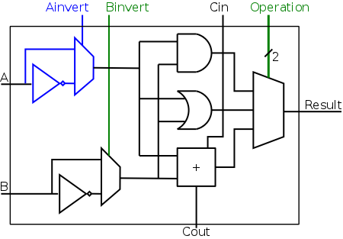
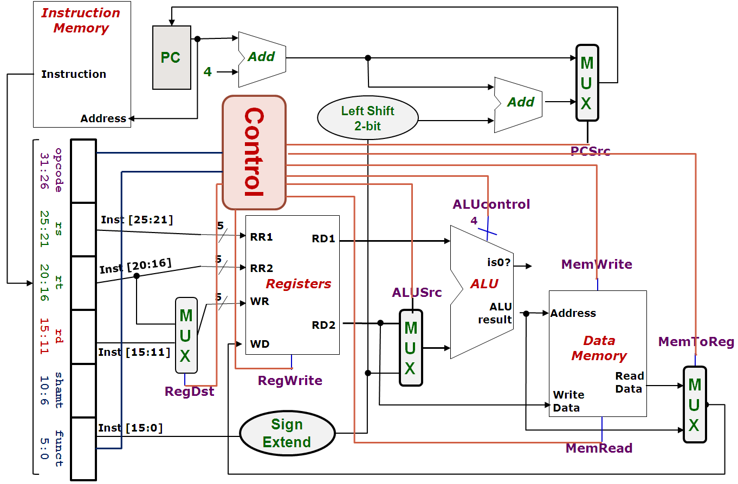
MIPS-Revision
ALUcontrol | Function
0000 | AND
0001 | OR
0010 | add
0110 | subtract
0111 | slt
1100 | NOR

Slide 10
5. One Bit At A Time (Aha!)
Can you see how the ALUcontrol (4-bit) signal controls the ALU?
Note: implementation for slt not shown
ALUcontrol |  |  | Function
Ainvert | Binvert | Operation
0 | 0 | 00 | AND
0 | 0 | 01 | OR
0 | 0 | 10 | add
0 | 1 | 10 | subtract
0 | 1 | 11 | slt
1 | 1 | 00 | NOR
Acknowledgement: Image taken from NYU Course CSCI-UA.0436

Slide 11
5. Multilevel Decoding
Now we can start to design for ALUcontrol signal, which depends on:
Opcode (6-bit) field and Function Code (6-bit) field
Brute Force approach:
Use Opcode and Function Code directly, i.e. finding expressions with 12 variables
Multilevel Decoding approach:
Use some of the input to reduce the cases, then generate the full output
Simplify the design process, reduce the size of the main controller, potentially speedup the circuit

Slide 12
5. Intermediate Signal: ALUop
Basic Idea:
Use Opcode to generate a 2-bit ALUop signal
Represents classification of the instructions:
Use ALUop signal and Function Code field (for R-type instructions) to generate the 4-bit ALUcontrol signal
Instruction type | ALUop
lw / sw | 00
beq | 01
R-type | 10

Slide 13
5. Two-level Implementation
Step 1.
Generate 2-bit ALUop signal from 6-bit opcode.
6
Control
Step 2.
Generate ALUcontrol signal from ALUop and optionally 6-bit Funct field.
ALUop
2
00: lw, sw
01: beq
10: add, sub, and, or, slt
opcode
31:26
rs
25:21
rt
20:16
rd
15:11
shamt
10:6
funct
5:0
ALU
4
ALUcontrol
0000: and
0001: or
0010: add
0110: sub
0111: set on less than
ALU Control
6

Slide 14
5. Generating ALUcontrol Signal
Opcode | ALUop | Instruction Operation | Funct field | ALU action | ALU control
lw |  | load word |  | add
sw |  | store word |  | add
beq |  | branch equal |  | subtract
R-type |  | add |  | add
R-type |  | subtract |  | subtract
R-type |  | AND |  | AND
R-type |  | OR |  | OR
R-type |  | set on less than |  | set on less than
Instruction Type | ALUop
lw / sw | 00
beq | 01
R-type | 10
00
xxxxxx
0010
00
xxxxxx
0010
01
xxxxxx
0110
10
10 0000
0010
10
10 0010
0110
10
10 0100
0000
ALUcontrol | Function
0000 | AND
0001 | OR
0010 | add
0110 | subtract
0111 | slt
1100 | NOR
10
10 0101
0001
10
10 1010
0111
Generation of 2-bit ALUop signal will be discussed later


Slide 15
5. Design of ALU Control Unit (1/2)
Input: 6-bit Funct field and 2-bit ALUop
Output: 4-bit ALUcontrol
Find the simplified expressions
ALUcontrol3 = 0
ALUcontrol2 = ?
ALUop0 + ALUop1⋅ F1
 | ALUop |  | Funct Field ( F[5:0] == Inst[5:0] ) |  |  |  |  |  | ALU control
 | MSB | LSB | F5 | F4 | F3 | F2 | F1 | F0
lw
sw
beq
add
sub
and
or
slt
0
0
X
X
X
X
X
X
0 0 1 0
0
0
X
X
X
X
X
X
0 0 1 0
X
0
1
X
X
X
X
X
X
0 1 1 0
1
0
1
0
0
0
0
0
0 0 1 0
X
X
X
1
0
1
0
0
0
1
0
0 1 1 0
X
X
X
1
0
1
0
0
1
0
0
0 0 0 0
X
X
X
1
0
1
0
0
1
0
1
0 0 0 1
X
X
X
1
X
X
X
0
1
0
1
0
1
0
0 1 1 1


Slide 16
5. Design of ALU Control Unit (2/2)
Simple combinational logic
ALUop
2
ALU Control block
ALUcontrol2
= ALUOp0 + ALUOp1∙F1
ALUOp0 (LSB)
ALUOp1 (MSB)
ALUcontrol3
0
ALUcontrol2
F3
ALUcontrol1
ALUcontrol
F2
F(5-0)
F1
ALUcontrol0
F0

Slide 17
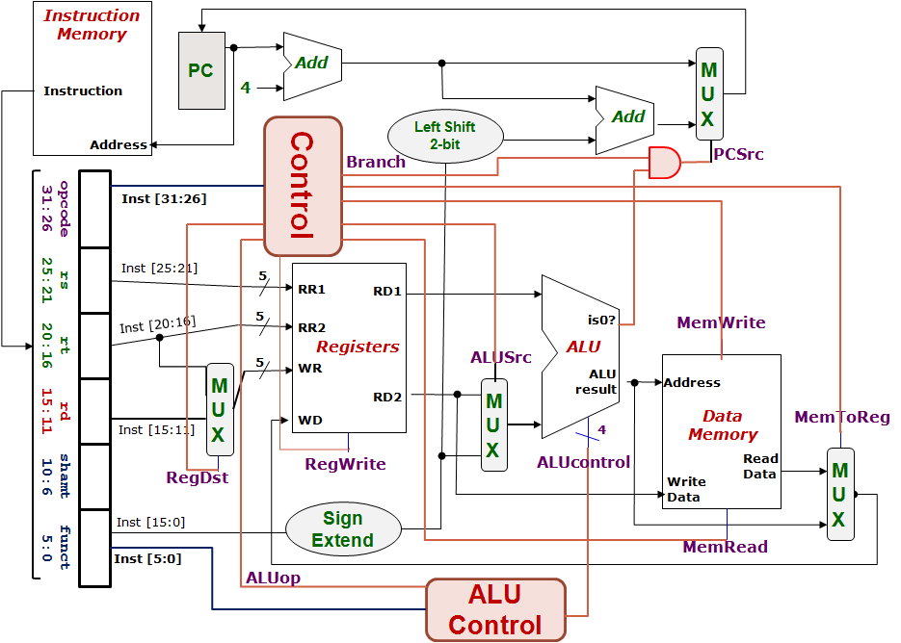
5. Control Design: Outputs
 | RegDst | ALUSrc | MemToReg | Reg Write | Mem Read | Mem Write | Branch | ALUop
 |  |  |  |  |  |  |  | op1 | op0
R-type
lw
sw
beq
1
0
0
1
0
0
0
1
0
0
1
1
1
1
0
0
0
0
X
1
X
0
0
1
0
0
0
X
0
X
0
0
0
1
0
1


Slide 18
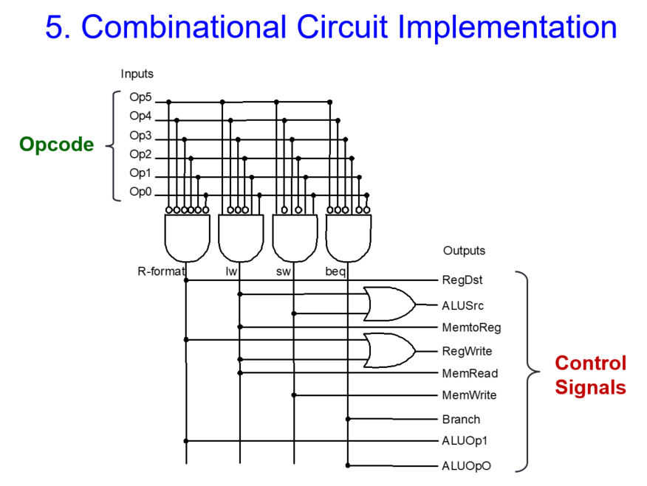
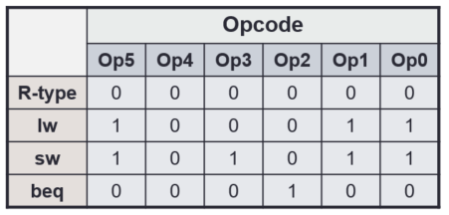
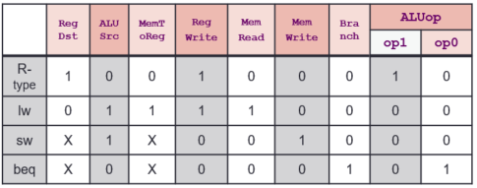
Final Control Circuit

Slide 19
Quiz Solutions

Slide 20
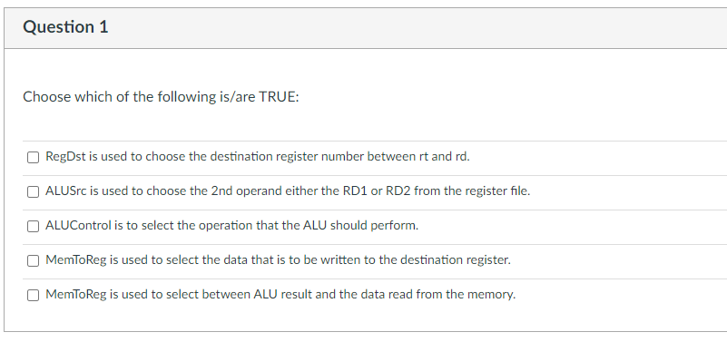
Week-6 MIPS Quiz

Slide 21
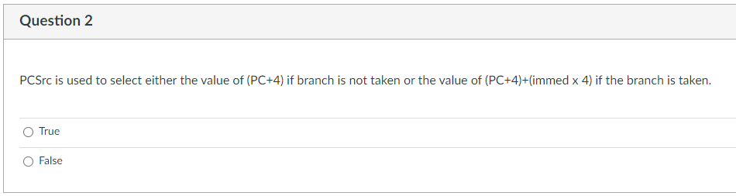
Week-6 MIPS Quiz

Slide 22
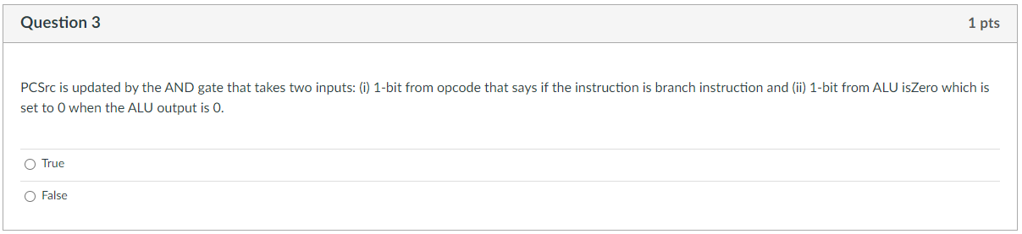
Week-6 MIPS Quiz

Slide 23
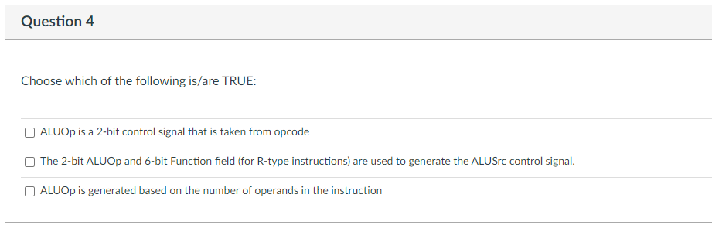
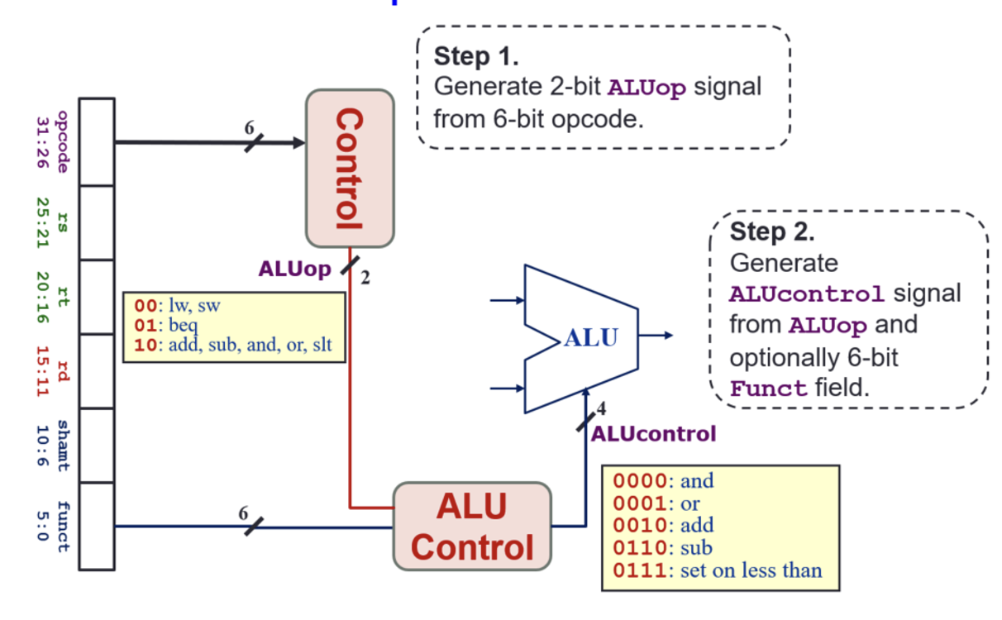
Week-6 MIPS Quiz

Slide 24
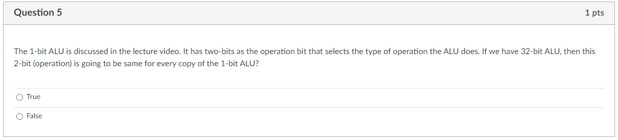
Week-6 MIPS Quiz

Slide 25
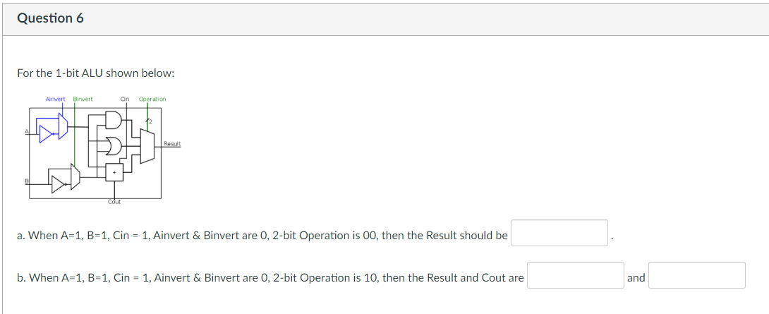
Week-6 MIPS Quiz
1
1
1

Slide 26
Slido Q/A

Slide 27
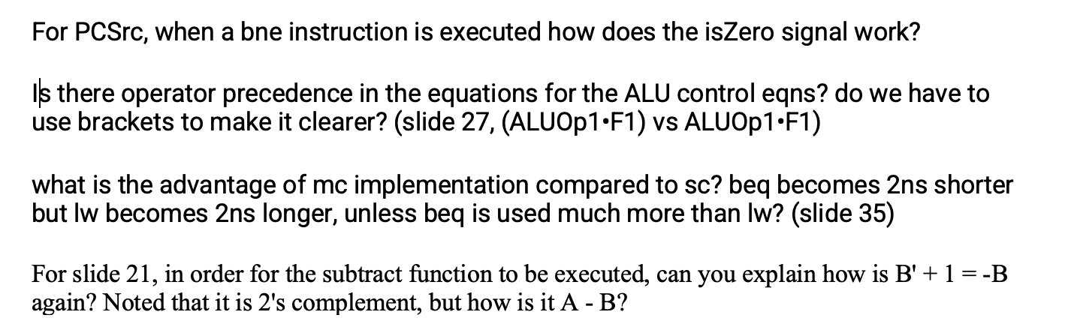
Slido Questions

Slide 28
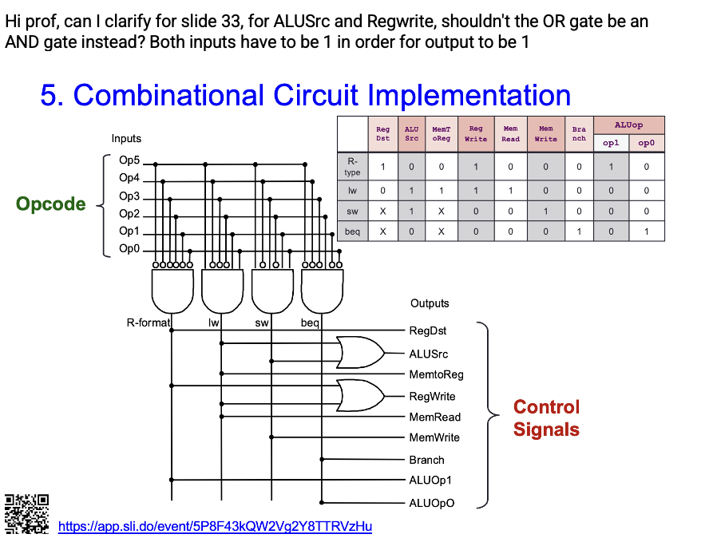
Slido Questions

Slide 29
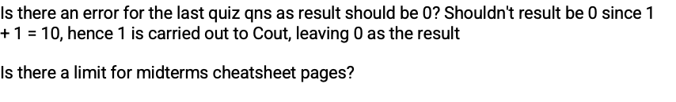
Slido Questions

Slide 30
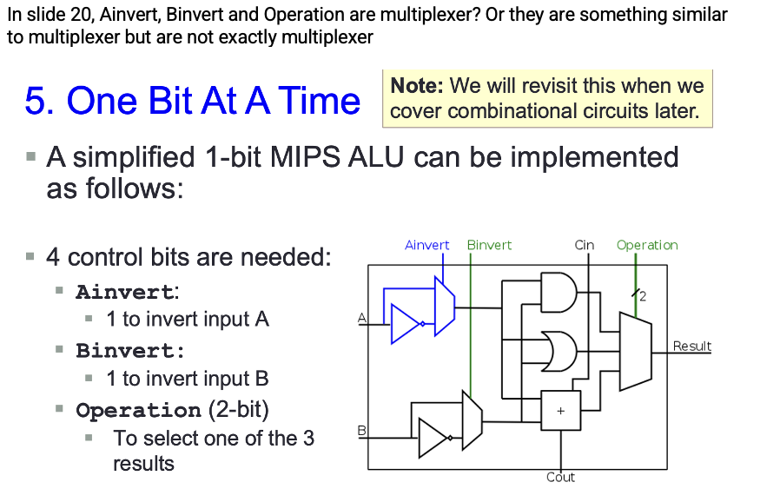
Slido Questions

Slide 31
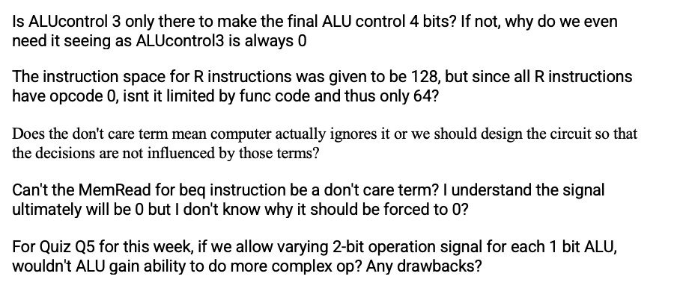
Slido Questions

Slide 32
End of File

